Slide 1
TeamOne
Members
- Jay Turakhia
- Shlok Gandhi
- Chirayu Desai

Slide 2
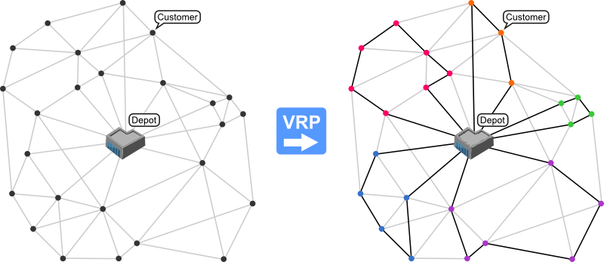
Vehicle Routing Problem
Image Source - http://neo.lcc.uma.es/vrp/vehicle-routing-problem/
Notes:
“Variables” ( several depots, dispersed cities /customers, vehicle fleet / delivery executives)

Slide 3
(Capacitated) Vehicle Routing Problem
CVRP
The objective - To deliver a set of customers with known demands on minimum-cost vehicle routes originating and terminating at a depot.

Slide 4
CVRP
Practical scenarios kept in mind
Finite set of customers
No restriction on number of trucks
Capacity restricted to avoid the following situation

Slide 5
Solutions
Heuristics
Improved savings: built on the idea of Clark and Wright
2-Phase (Cluster first, solve later)
Sweep (Cluster)
TSP (solution)
Meta Heuristics
Genetic Algorithm 1
Genetic Algorithm 2

Slide 6
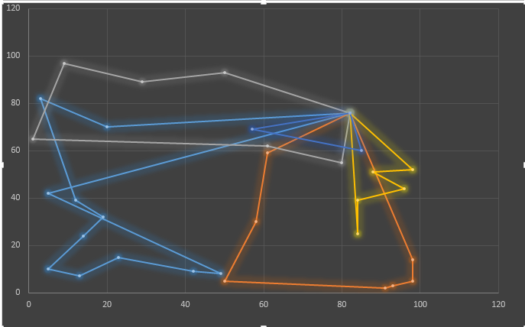
Improved Savings
Depot
Customers
Generate savings pairs
Measure of distance points saved by pairing two arbitrary customers in a route
Rank in reverse order
Start with the first savings pair
Add to new route
Find a pair with one node connected
Iterate and fit to trucks as per capacity
Source : http://ieeexplore.ieee.org/document/7784340
Wang Xing, Zhao Shu-Zhi ; Wang Xing, Chu Hao ; Li Yan

Slide 7
Solutions
Heuristics
Improved savings: built on the idea of Clark and Wright
2-Phase (Cluster first, solve later)
Sweep (Cluster)
TSP (solution)
Meta Heuristics
Genetic Algorithm 1
Genetic Algorithm 2

Slide 8
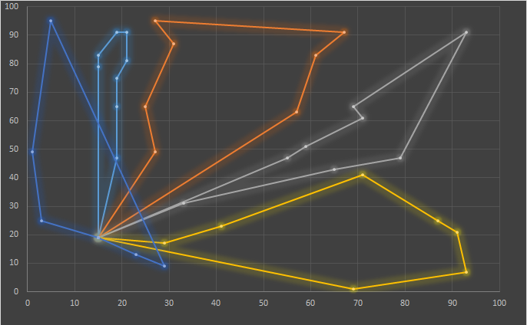
2-phase : Cluster-first , Route-Second
Sweep Algorithm to cluster
Radially group customers and form clusters as per capacity with center as depot
Multiple approaches possible
Our implementation. Clockwise + Euclidean distance
Apply these customers’ clusters to TSP (Google OR tools)
Generate routes

Slide 9
Solutions
Heuristics
Improved savings: built on the idea of Clark and Wright
2-Phase (Cluster first, solve later)
Sweep (Cluster)
TSP (solution)
Meta Heuristics
Genetic Algorithm 1
Genetic Algorithm 2

Slide 10
Genetic Algorithms Approach 1
Generate Population (Random)
Selection (Based on Fitness Function)
Crossover
Mutation
Chromosome Structure
{ DEPOT – NODE1 – NODE2 – DEPOT – NODE3 – NODE4 – NODE5 - DEPOT}
{ DEPOT – NODE4 – NODE2 –NODE3 – DEPOT – NODE1 – NODE5 - DEPOT}
.
.

Slide 11
Solutions
Heuristics
Improved savings: Clark and Wright
2-Phase (Cluster first, solve later)
Sweep (Cluster)
TSP (solution)
Meta Heuristics
Genetic Algorithm 1
Genetic Algorithm 2

Slide 12
Genetic Algorithms Approach 2
The initial population generated for genetic algorithm should not be highly random.
Generate A More Robust Population Before Applying Genetic Algorithm.

Slide 13
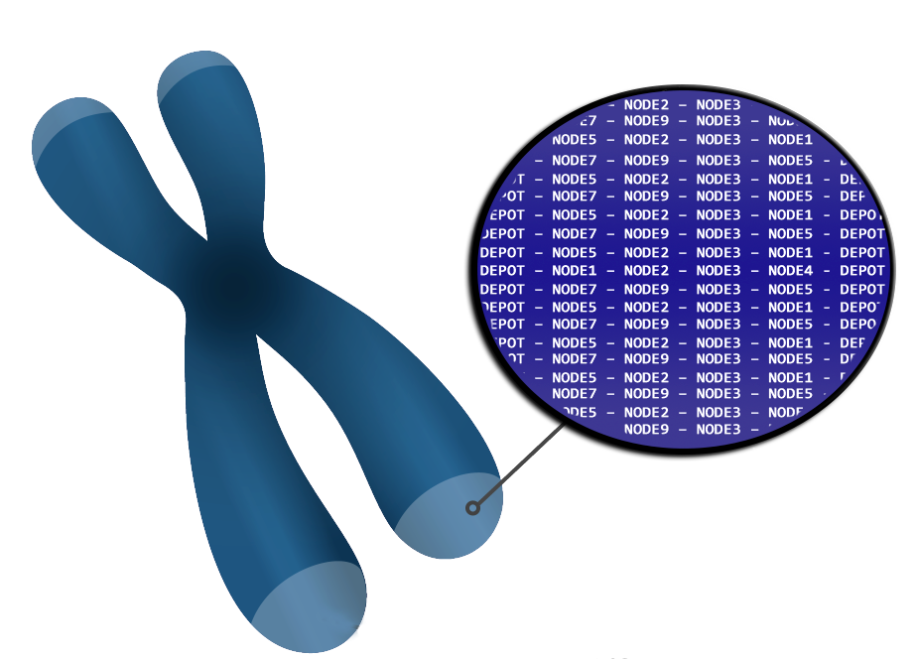
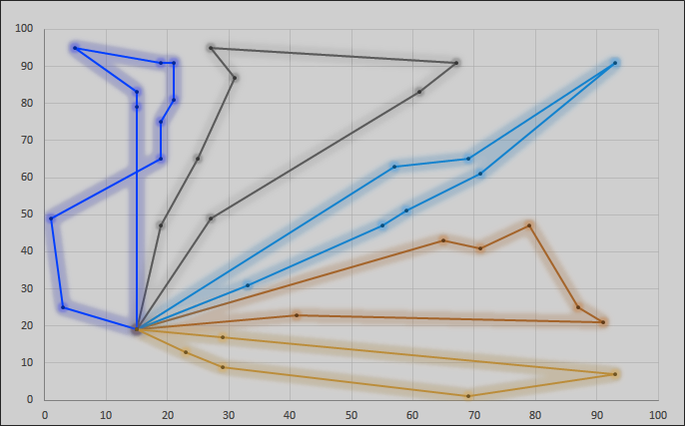
Apply Sweep to order nodes radially.
Each Vehicle traverses greedily to radially closest node and generates a route.
Generate Population By Generating mutated versions of the found route.
Select parents to cross based on fitness i.e. minimum route cost.
Generate Children By Crossover and Mutation.
Repeat Until all Nodes are covered.
Chromosome Structure
.
.
.
{ DEPOT – NODE1 – NODE2– NODE3 – NODE4 – NODE5 - DEPOT}
.
{ DEPOT – NODE4 – NODE2 –NODE3 – NODE1 – NODE5 - DEPOT}
.
.
.
Customers
Depot

Slide 14
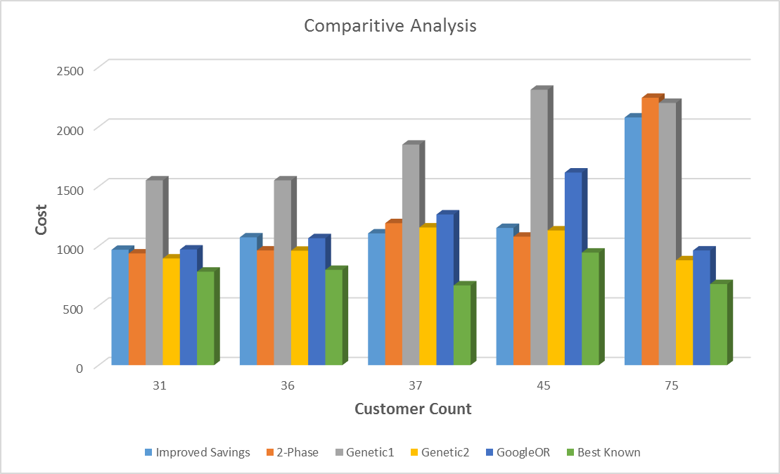
Evaluation and Results

Slide 15
Conclusion
No single solution fits all types of customer distribution.
Performance varies as per customer distribution.
Time taken to solve changes drastically . - might matter when we want to dynamically update routes.
Search is needed almost everywhere at some stage.
High exploration rate doesn't necessarily generate the best solution.

Slide 16
Division of implementations
Jay – Implementation of Improved savings, Partial implementation of sweep
Shlok – Genetic algorithm, Partial implementation of sweep
Chirayu – Genetic Algorithm, with sweep and local greedy search
Common Tasks :
Research various approaches.
Data accumulation.
Evaluate implementations
Compare results.

Slide 17
References
http://www.orcomplete.com/computer/sertalpbilal/solving-vehicle-routing-problem
http://neo.lcc.uma.es/vrp/vehicle-routing-problem/
http://www.jstor.org/stable/2627477?origin=JSTOR-pdf
G. Clarke and J. Wright “Scheduling of vehicles from a central depot to a number of delivery points”, Operations Research, 12 #4, 568-581, 1964.
M. L. Fisher and R. Jaikumar. “A Generalized Assignment Heuristic for Vehicle Routing”. Networks, 11:109-124, 1981.
Alba, E., Dorronsoro, B. “Solving the Vehicle Routing Problem by Using Cellular Genetic Algorithms”, Conference on Evolutionary Computation in Combinatorial Optimization, EvoCOP 2004, LNCS vol. 3004, pp 11-20, Portugal, Springer-Verlag. 2004.
Google OR Tools - https://developers.google.com/optimization/

